Slide 1
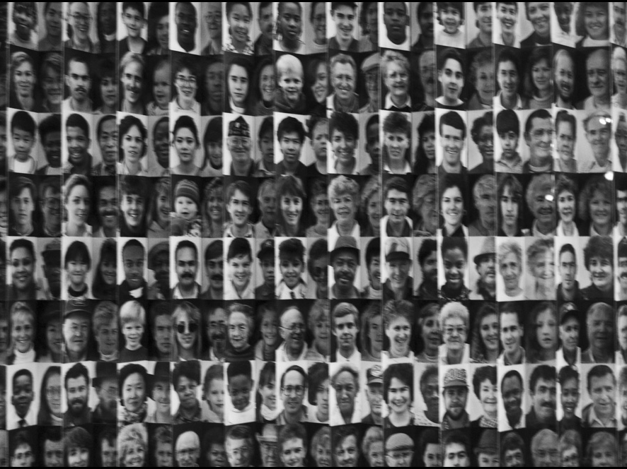
  “Where Justice Meets Compassion:
  A Christian Assessment of Illegal Immigration”
Kevin Twain Lowery, Ph.D.
Courtney Fuqua

Slide 2
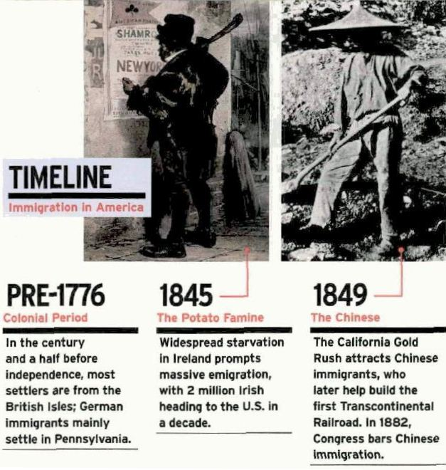

Slide 3
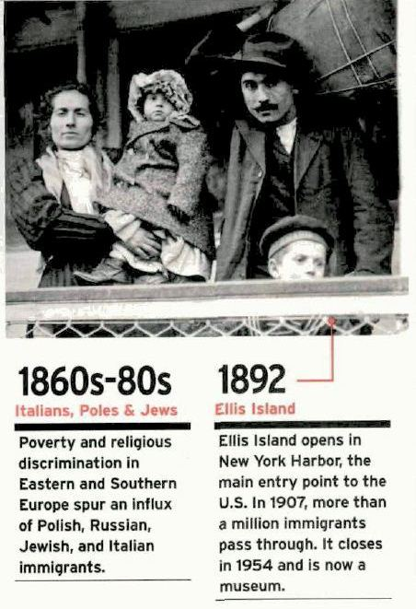

Slide 4
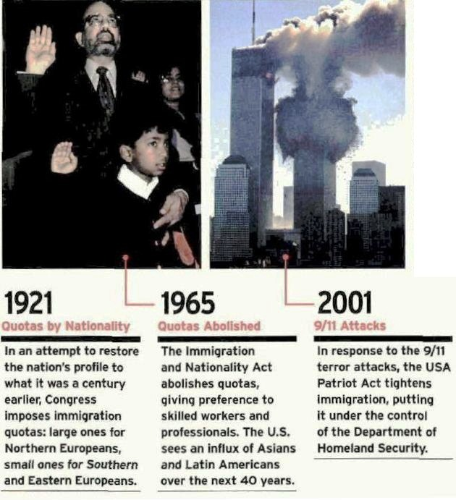

Slide 5
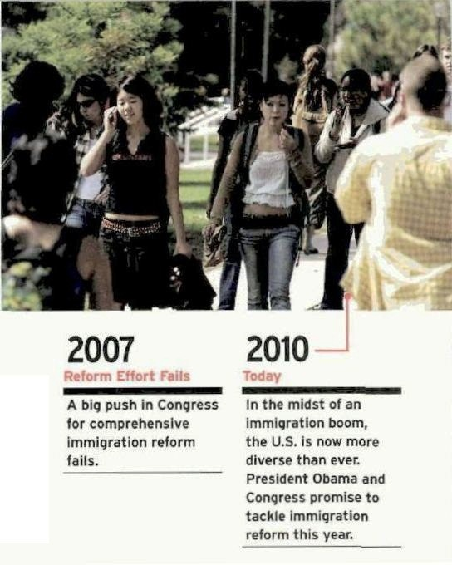

Slide 6
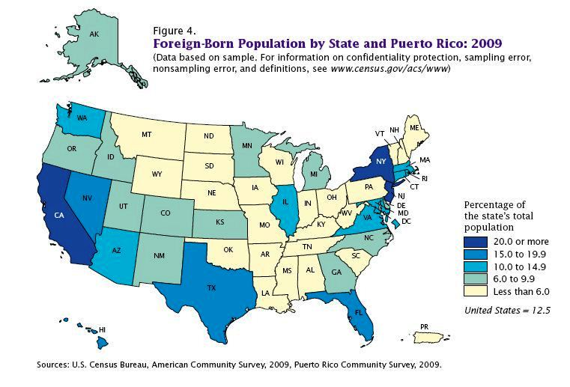

Slide 7
Public POLL: Immigration Levels

Slide 8
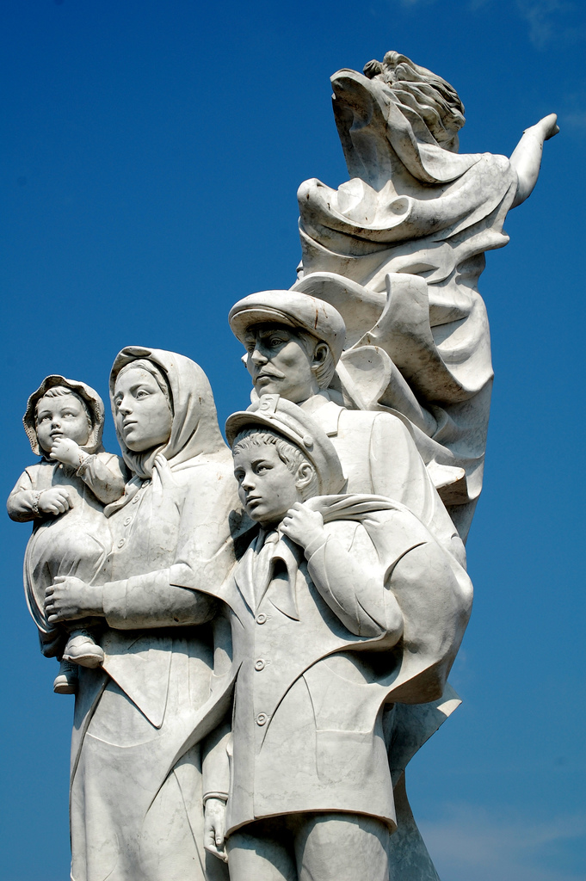
Fact
  As many as one-half of all undocumented immigrants came here legally on visas. They just never returned when their visas expired.

Slide 9
Public Poll: Attitudes Toward Immigrants
Do you believe that immigrants contribute to society, or do they cause problems?

Slide 10
Is immigration opposition fueled by prejudice (at least partially)?
Statistics show that people tend to accept immigrants more after they have had exposure to and interaction with immigrants.
E.g. California
California has generally been moving toward greater acceptance of immigrants, even illegal ones.
In 1982, the Field Poll found that only 19% of voters thought illegal immigrants had a favorable effect on the state. By July 2010, 34% felt that way.
Likewise, the proportion of voters who felt illegal immigrants had a negative impact had dropped from 75% to 56%.
In 1982, 52% of voters felt illegal immigrants were taking jobs away from legal Californians; by July 2010, only 34% felt that way.”

Slide 11
Public Poll: Relations Between Americans and Immigrant Hispanics

Slide 12
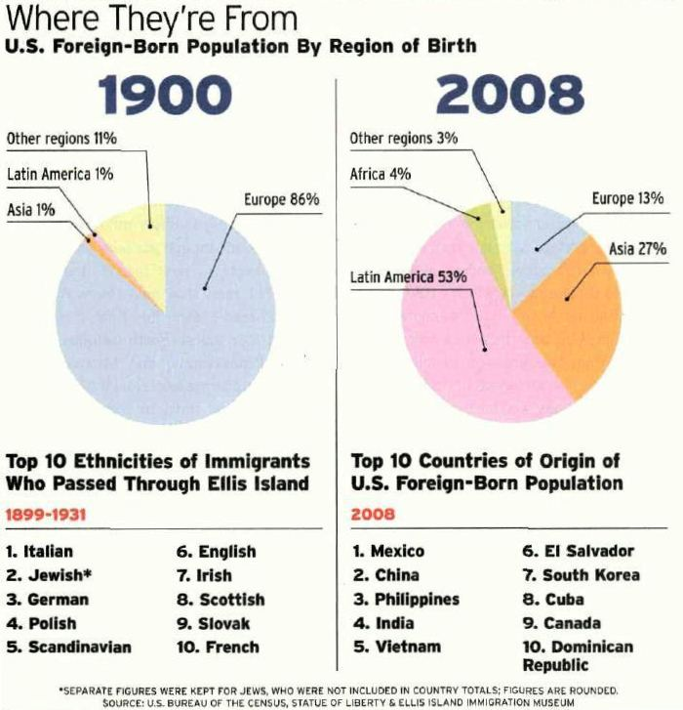

Slide 13
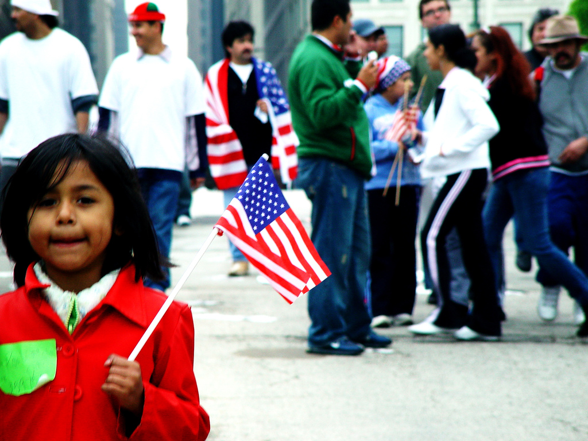
Hispanic Immigrants: Population Growth
  Hispanics are the fastest growing ethnic minority group in the country
  By 2050, it is estimated that one in every four Americans (more than 100 million residents) will be Hispanic.

Slide 14
Hispanic Immigrants: Economics
Only 2/3 of Hispanics have a bank account, whereas 95% of non-Hispanic whites have a bank account.
A greater proportion of Hispanics (33%; 14 million people) lack health insurance than do non-Hispanic whites (11%), Native Americans (30%) and non-Hispanic blacks (20%).
This lack is greatest among foreign-born and predominantly Spanish-speaking Hispanics.

Slide 15

Hispanic Immigrants: Discrimination
  75% of Hispanics state that discrimination is a problem in schools
  78% say it is a problem in the work place
  41% say they receive poorer service in restaurants, etc.
  They attribute much of this to language and appearance.

Slide 16
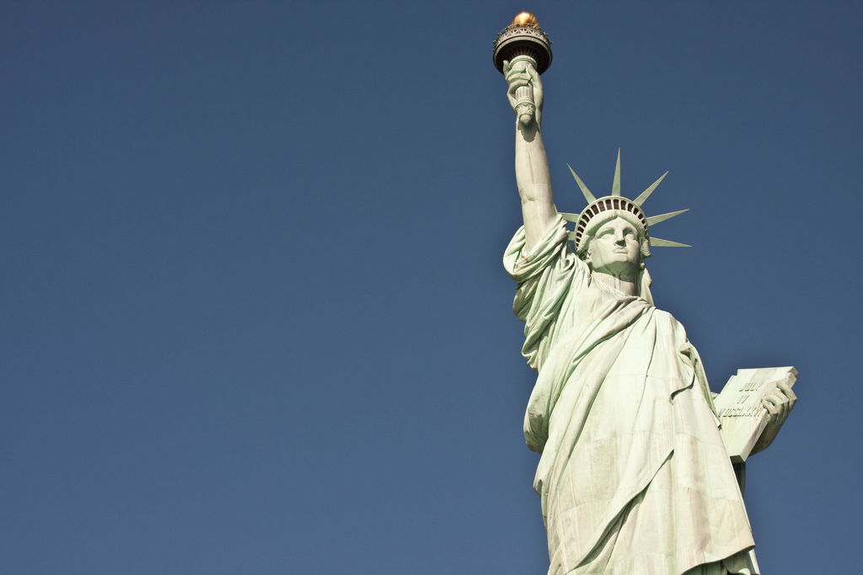
Hispanic Immigrants: The Language Barrier
Spanish is the dominant language among 47% of foreign born Hispanics.
However, Spanish is the dominant language for only 7% among second generation Hispanics.
English is the dominant language among 61% of native-born Hispanics.

Slide 17
Public Poll:
Immigration and Economics

Slide 18
Impact on Wages
Upper class – unaffected
Middle and lower class – wages could be up to 10% lower

Slide 19
Impact on Jobs
Some impact on lower-wage jobs
Expenditures of immigrants helps to create some lower-wage jobs

Slide 20
Economic Impact
We are feeding the bottom of the job market while starving the top.
College-educated immigrants, often with skills that benefit the U.S., can find it difficult to get work simply because the jobs they do are legal.
In contrast, the lack of enforcement of labor laws at the bottom of the economic ladder makes it easy for low-skilled illegal workers to find employment.

Slide 21
Job Competition
According to a 2006 study by Paul Harrington of the Center for Labor Market Studies at Northeastern University, foreign-born workers as a whole (about half of whom are illegal) are much younger than the general population and are successfully competing against less-educated American workers.
Teen employment is at its lowest rate since World War II.

Slide 22
Occupations With the Highest Percentages of Illegal Immigrants

Slide 23
The Financial Liability of Undocumented Immigrants
Education
State-level expense
Both undocumented children and children born in the U.S. (viz. citizens)
Health care
Mainly a local-level expense (NB hospitals)
Incarceration

Slide 24
Raising the Tax Burden of Citizens
Florida
Unauthorized immigrants comprised 8.2 percent of Florida's workforce, or 750,000 workers, in 2008, according to a Pew Hispanic Center report.
The Federation for American Immigration Reform estimates that the state of Florida spends $3.8 billion on education, health and incarceration for illegal immigrants.

Slide 25
Raising the Tax Burden of Citizens
Arizona's illegal immigrant population is costing the state's taxpayers about $1.3 billion per year.

Slide 26
Raising the Tax Burdens on Citizens
California's estimated 2.7 million illegal residents (7% of the state's population) add $4-6 billion annually in costs.
State payments for the American-born children of immigrants supposedly cost about $640 million a year.

Slide 27
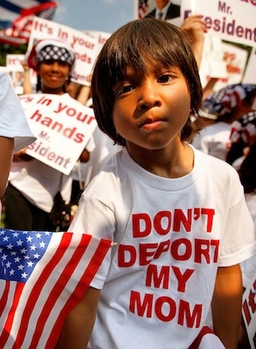
U.S.-Born Children of Illegal Immigrants
According to the traditional interpretation of the citizenship clause of the U.S. Constitution’s Fourteenth Amendment, any child born in the U.S. to parents who are “under the jurisdiction” of the U.S. government is automatically a U.S. citizen.
Consequently, children of illegal immigrants are U.S. citizens if born in the U.S., even though their parents are not citizens.
Sometimes these children are controversially referred to as “anchor babies” since they help to “anchor” the parents in the U.S.

Slide 28
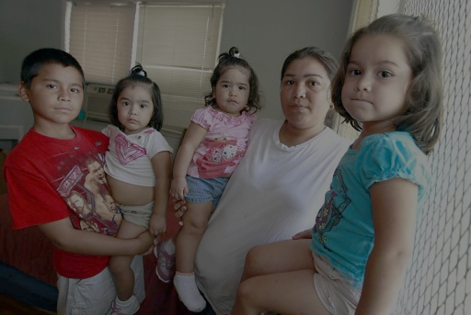
Reinterpreting the Citizenship Clause
  Some claim that only citizens of the U.S. are “under the jurisdiction” of the U.S. government.
  Under consideration are a number of proposals to deport illegal immigrant parents of U.S.-born children, with or without their children.

Slide 29
Important Questions Raised By the Citizenship Clause
What is the relationship between parental rights and the rights of citizenship?
  Are parental rights derived from citizenship?
  Do the citizenship rights of children supersede parental rights?
Is the welfare of children the overriding concern?
  Does it limit or preclude the punishment of immigration crimes?
  What is the responsibility of the state over and against that of the parents?

Slide 30
Illegal Immigration and Crime
Of the 392,862 aliens the ICE deported in 2010, 195,772 had criminal records.
Approximately 1,000 had been convicted of murder
Approximately 6,000 had been convicted of sex offenses
Approximately 28,000 had drunken-driving convictions
In addition to deportations, the ICE also audited more than 2,200 companies and charged 180 owners, employers or managers for hiring illegal workers.

Slide 31
Illegal immigrants fitting into the system
Individual Taxpayer Identification Number (ITIN)
Taxes are withheld from all workers (including illegal immigrants) earning at least $1,700 annually.
The ITIN was created so that taxes could be collected from people without a Social Security Number.
The IRS is not permitted to share taxpayer information with other government agencies.
Many banks are willing to accept the ITIN in lieu of a SSN for opening an account.

Slide 32
Illegal Immigrants Fitting Into the System
Utility companies, etc. – generally willing to accept the business of illegal immigrants
Driver’s licenses
Some states issue driver’s licenses to those without a SSN (perhaps having an ITIN instead)
Allowing illegal immigrants to get driver’s licenses permits them to get auto insurance, helping to reduce the number of uninsured (and unlicensed) drivers.

Slide 33

The Arizona Immigration Law
In April 2010, Arizona passed the broadest and strictest immigration measure in generations, making the failure to carry immigration documents a crime and giving the police broad power to detain anyone suspected of being in the country illegally

Slide 34

Summary of Immigration Law
A law enforcement official has made a lawful stop, detention or arrest of an individual.
A law enforcement official has developed a reasonable suspicion the individual is not in this country legally (i.e. failure to produce identification).
On the basis of this reasonable suspicion, a law enforcement official contacts ICE to verify the individual's immigration status.

Slide 35

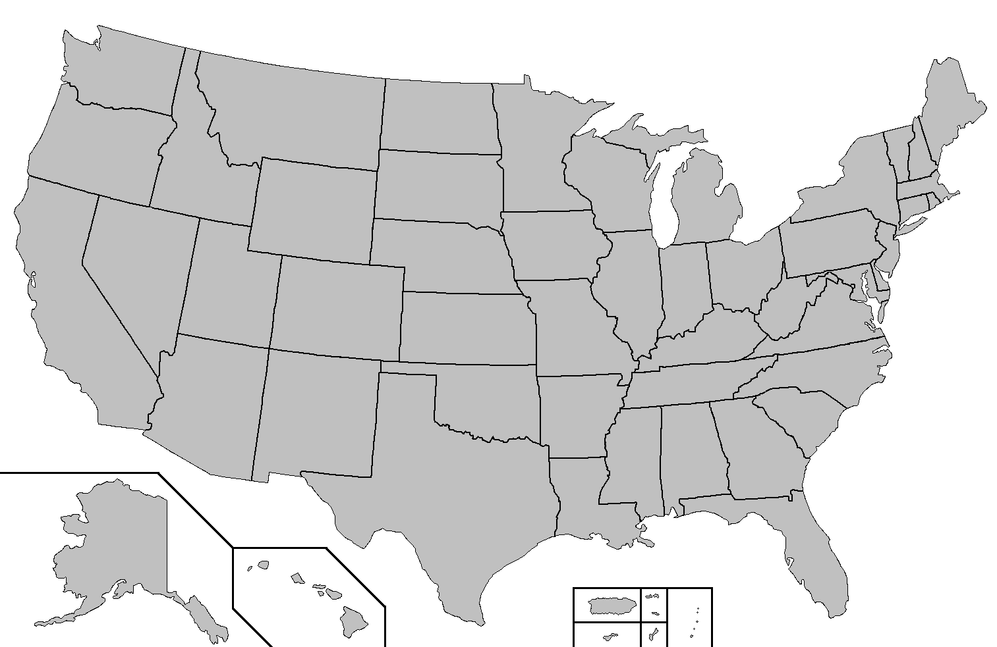
Duplicating the State of Arizona?
State immigration legislation (similar to that of Arizona) is being considered in:
  Idaho
  Utah
  Missouri
  Texas
  North Carolina
  Maryland
  Minnesota
  Colorado

Slide 36
Impact of the Arizona Law
According to some reports, the new law has hampered Hispanic ministries in Arizona.
Many Hispanic people are afraid to go to church, and church employees (including pastors) feel at risk of being fined for harboring illegal immigrants.

Slide 37
Public Poll:
Does the Arizona Law Go Too Far?

Slide 38
Immigrants in the bible
Abraham is depicted as an immigrant/stranger. (Gen. 11:27-12:5; Deut. 26:5-10)
Joseph carried out a special mission from God as an alien. (Gen. 45:4-8; 50:19-21)
Moses was also an alien in the land of Midian. (Ex. 18:1-3)
Ruth was likewise a foreigner in Moab. (Ruth 2:10)
Israel saw itself as a pilgrim people. (I Chron. 29:14-15)
Peter says that Christians are aliens on earth. (I Pet. 2:9-11)

Slide 39
Being Kind to the Alien
Israel was commanded to not mistreat aliens because they, too, were aliens. (Ex. 22:21; 23:9; Deut. 10:17-22)
Part of the harvest was to be left behind for the poor and the aliens. (Lev. 19:10; 23:22; Deut. 24:19-21; 26:12-13)
“When an alien lives with you in your land, do not mistreat him. The alien living with you must be treated as one of your native-born. Love him as yourself, for you were aliens in Egypt. I am the LORD your God.” (Lev. 19:33-34)

Slide 40
Jesus Casts Foreigners in a Positive Light
Syrophenician woman (Mt. 15:21-28; Mk. 7:24-30)
Roman centurion (Mt. 8:5-13; Lu. 7:1-10)
Leper who returned to give thanks. (Lu. 17:11-19)
Good Samaritan (Lu. 10:30-37)

Slide 41
Jesus Commands Us to Be Hospitable
Matthew 5:39-42
  “ But I say to you, do not resist him who is evil; but whoever slaps you on your right cheek, turn to him the other also.
  “And if anyone wants to sue you, and take your shirt, let him have your coat also.
  “And whoever shall force you to go one mile, go with him two.
  “Give to him who asks of you, and do not turn away from him who wants to borrow from you.”

Slide 42
Christian Response:
The NAE
In 2009 the National Association of Evangelicals endorsed comprehensive immigration reform, indicating its belief that new policies should reflect “biblical grace to the stranger.”
The NAE stressed the need for family reunification and for a fair process that would allow undocumented immigrants to earn legal status.

Slide 43
Christian Response: Christianity Today
  In June 2009, Christianity Today urged its readers to “call on political leaders to substantially improve border security and require law enforcement to use humane enforcement methods; provide better means for employers to check potential workers' status without violating privacy, and better prevent illegal recruitment of migrant workers; amend laws to end the backlog of immigration applications, provide viable pathways for otherwise law-abiding illegal immigrants to resolve their residency status, and establish stronger family reunification programs; and create regional pilot programs for guest workers and their families with enforceable, market-sensitive guidelines.”

Slide 44
The need For Reform
In 1986,
Congress passed an immigration law with many loopholes, and the number of illegal immigrants soared from 3 million then to an estimated 11 million today.
Without reform that works, that number could more than double in the next generation.

Slide 45
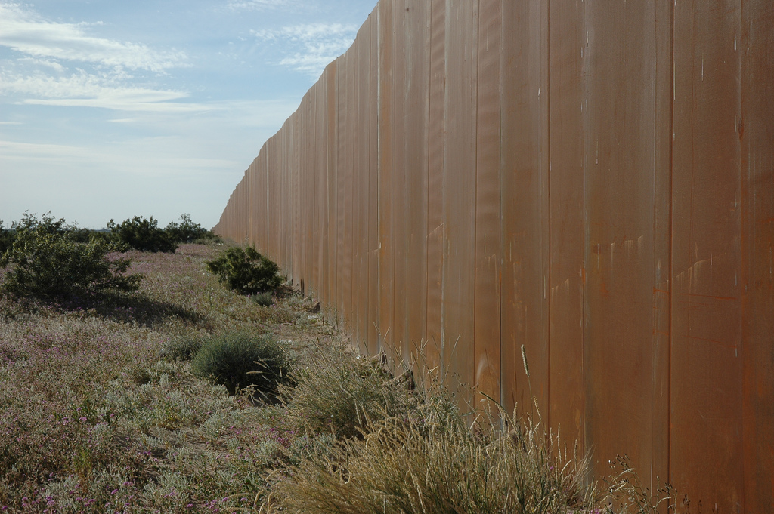
Options for Protecting the Border
Partial fence utilizing natural obstacles (e.g. mountains, rivers, etc.)
Border patrols – expensive
Virtual fence (i.e. cameras, radar, communication technology) – expensive and unsuccessful to date
Predator “drones” – cost $4.5 million each plus manpower for pilots to operate them (i.e., They run by remote control, not autonomously.)

Slide 46
A Proposal
The U.S. should consider offering more visas to educated and skilled immigrants.
Nations like West Germany and Israel benefitted greatly from this kind of immigration.

Slide 47

The Dream Act
  The “Dream Act” is a newly proposed act that would allow people who are were under the age of 16 when they came to America to go through a progressive program of getting citizenship.

Slide 48
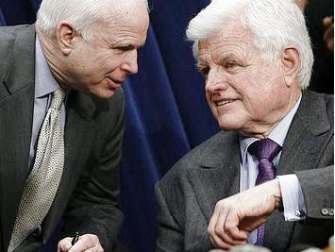
Government Inaction
Ted Kennedy and John McCain introduced the Comprehensive Immigration Reform Act of 2007, but it failed.

Slide 49
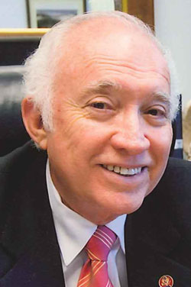
Government Inaction
In December 2009, Texas congressman Solomon Ortiz introduced a similar billed called the Comprehensive Immigration Reform for America’s Security and Protection Act of 2009.
The bill recommends that undocumented immigrants who were here by late 2009 receive six-year visas and later become permanent residents if they have jobs, undergo criminal background checks, learn English, and pay a $500 fine.
The bill has been in committee since March and doesn’t seem to be going anywhere.

Slide 50

Getting Past the Rhetoric

Slide 51
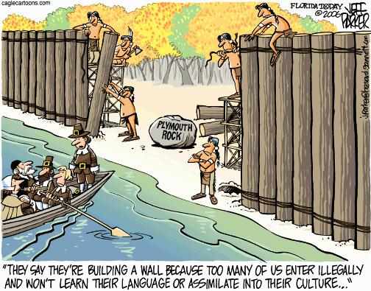
Getting Past the Rhetoric

Slide 52
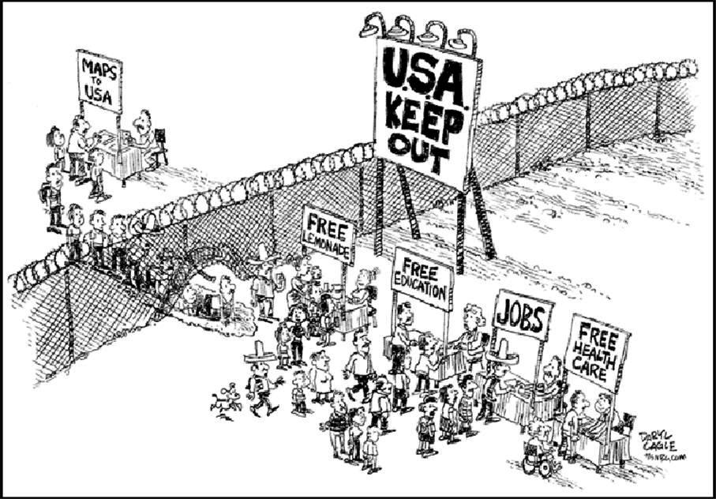
Getting Past the Rhetoric

Slide 53
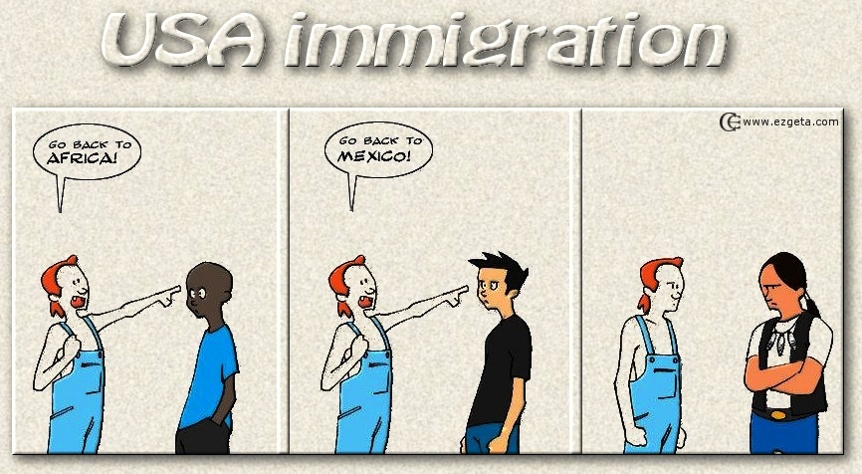
Getting Past the Rhetoric

Slide 54
Where Justice Meets Compassion:
Key Concerns
The plight of immigrant families, especially children
Economic justice and compassion
Enforcing U.S. (immigration) law
Assimilation of immigrants

Slide 55
Where Justice Meets Compassion:
Key Choices to Be Made
Number and types of visas issued
Defending our borders
What to do about the illegal immigrants already here
Deport or penalize
Path to citizenship
Assimilation
Compensating for negative economic impact

Slide 56
Bibliography
Brenner, Reuven. “Our Muddled Masses.” First Things (January 2010): 37-41.
“Church Workers and the Law.” Christian Century, v. 127, no. 12 (June 15, 2010): 24-5.
Decker, Cathleen. “A Jumbled View on Illegal Migrants: The Whitman Dustup Is a Metaphor for California's Conflicting Views on the Issue.” Los Angeles Times (October 2, 2010).
Dinan, Stephen. "More Criminal Aliens Deported Last Year." Washington Times [DC] (October 7, 2010): 1
Dolliver, Mark. “Checking on Attitudes about Immigrants.” Media Week, vol. 20, no. 19 (May 10, 2010): 23.
“Evangelical Group Endorses 'Fair' Immigration Reform.” Christian Century (November 3, 2009): 18.
Goldstein, Aaron. “Is Arizona's Immigration Law Being Put on ICE?” American Spectator (May 25, 2010)
“Immigration reform is about what's best for us: Compassion is only one facet of a complex problem.” Philadelphia Daily News (August 31, 2010).
Preston, Julia. “Raised in the U.S. but Still Illegal: How Should the U.S. Treat a Million Young People Who Were Brought Here Illegally as Children?” New York Times Upfront (March 15, 2010): 8-9
Salamon, Jeff. “Everything You Ever Wanted to Know about Illegal Immigration (But Didn’t Know Who to Ask).” Texas Monthly (November, 2010): 144-9.
Silva, Cristina. “Rick Scott Says 700,000 Illegal Immigrants Take Jobs.” St. Petersburg (FL) Times [Politifact.com edition] (August 18, 2010).
Smith, Patricia. “The Great Immigration Debate.” New York Times Upfront; 143:1 (September 6, 2010): 12-7.
“The Soul of the Border Crisis.” Christianity Today (June 2009): 18.
Van Engen, Charles. “Biblical Perspectives on the Role of Immigrants in God’s Mission.” Evangelical Review of Theology, 34:1 (2010): 29-43.
Waldman, H. Barry, and Steven P. Perlman. “Hispanic/Latino Population Social and Health Conditions: The Setting for Children and Adults with Disabilities.” The Exceptional Parent, 40:2 (Feb 2010): 51-5.
Wood , Daniel B. “After Arizona, Why Are 10 States Considering Immigration Bills?” Christian Science Monitor (May 10, 2010).

