Slide 1
Holiness as Complete
Bangkok Holiness Writers' Conference
September 2017

Slide 2
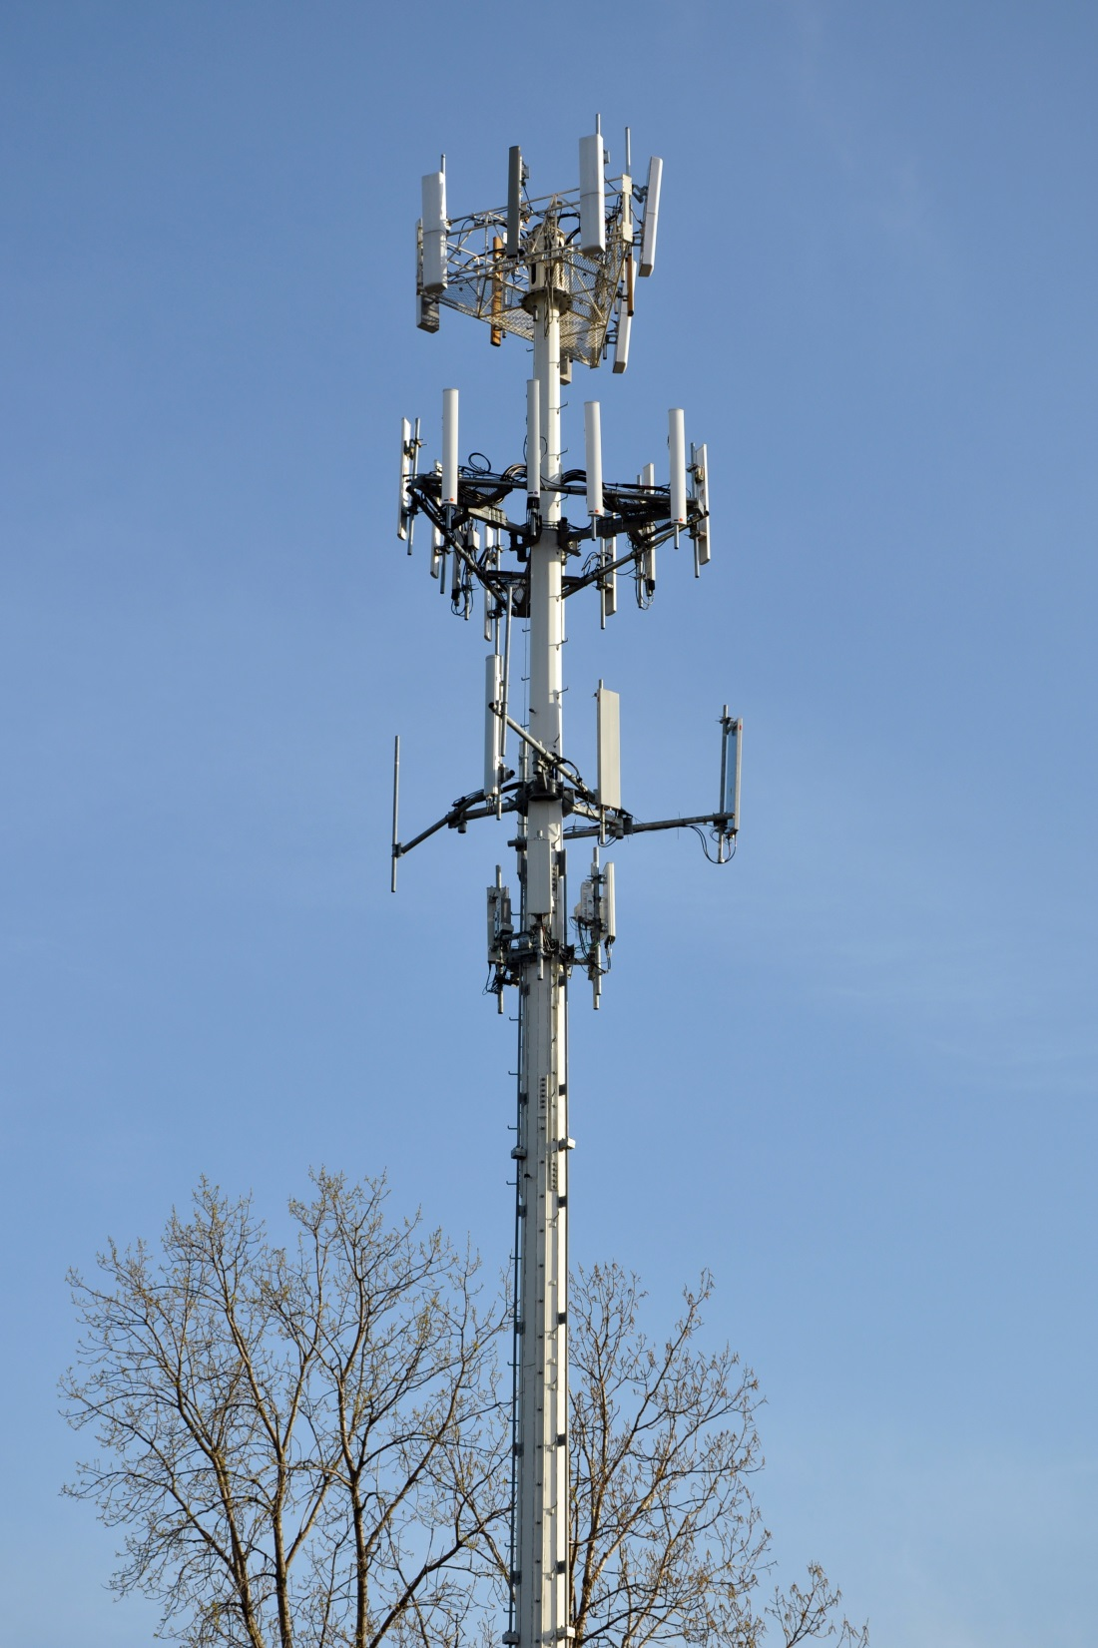

Slide 4
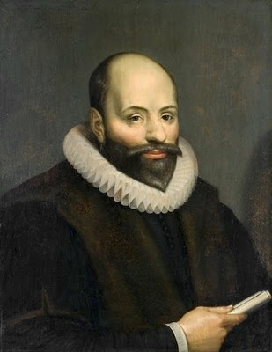

Slide 5
total depravity vs.
Total Depravity

Slide 6
Universal election vs.
Unconditional election

Slide 7
Unlimited atonement vs.
Limited atonement

Slide 8
Salvation for all vs.
Irresistible grace

Slide 9
Personal relationship with God vs.
Peseverance of the saints or
Once saved always saved

Slide 10
Calvinism vs. Wesleyanism
Genesis 3
Romans 7
Genesis 2
Romans 8

Slide 11
Optimism of grace =
full salvation

Slide 12
Quitting sin
Our old habits change
We use our money more wisely
Our language changes
All true!
But it’s more than willful “quitting sin”

Slide 13
Is our understanding of holiness just about changing our habits – habituation?
Absolutely not!!!

Slide 14
Always remember --
Our gift of salvation is freely given from Him
The Holy Spirit comes to us as a gift from the Father and the Son
He makes us holy – not ourselves
The power that raised Jesus from the dead works in us
We must never forget that!!!

Slide 15
Matthew 5:48
“Be perfect, therefore, as your heavenly Father is perfect.” (NIV)

Slide 17
God

Slide 18
God
Adam

Slide 19
God
Adam
Sin

Slide 20
God
Adam
Sin
The Law

Slide 21
God
Adam
Sin
The Law
Unrighteousness

Slide 22
God
Adam
Sin
The Law
Unrighteousness
Lost Humanity

Slide 23
God
Adam
Sin
Jesus The Law
Unrighteousness
Lost Humanity

Slide 24
God
Adam
Sin
Jesus The Law
Righteousness Unrighteousness
Lost Humanity

Slide 25
God
Adam
Sin
Jesus The Law
Righteousness Unrighteousness
Lost Humanity

Slide 26
God
Holiness
Holy Spirit Adam
Sin
Jesus The Law
Righteousness Unrighteousness
Lost Humanity

Slide 27
God
Holiness
Holy Spirit Adam
Sin
Jesus The Law
Righteousness Unrighteousness
Lost Humanity

Slide 28
God
Holiness
Holy Spirit Adam
Sin
Jesus The Law
Righteousness Unrighteousness
Lost Humanity

Slide 29
Matthew 5:48
Be perfect
Flawless?
Complete - fulfilling your intended purpose
Relationship with God!

Slide 30
Holiness - not “12 Steps to a new you” through changing habits. A relationship with God; letting Him transform you.

Slide 31
“Be perfect, therefore, as your heavenly Father is perfect.”
Jesus said it.
Perfect - not flawless, but complete
God’s plan - complete
Our connection to God - complete
Stay connected every day.

